Slide 1
A brief introduction of prompt learning for visual-language models
Kang Xin 2022/05/14

Slide 2
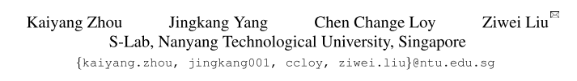
Conditional Prompt Learning for Vision-Language Models
CVPR 2022

Slide 3
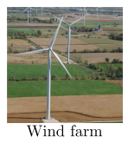


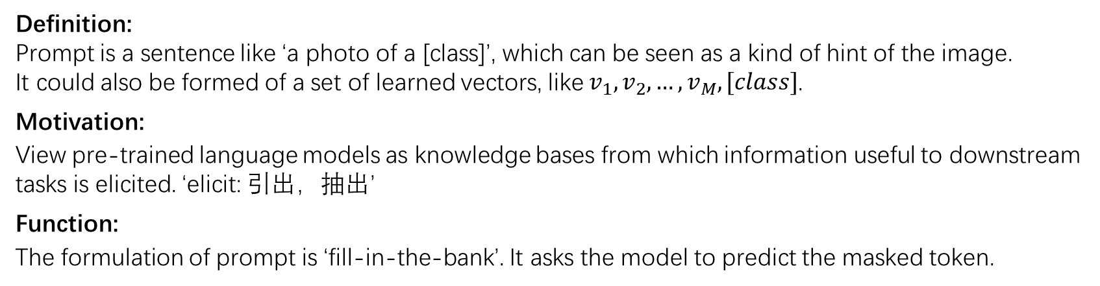
What is prompt?
Definition:
Prompt is a sentence like ‘a photo of a [class]’, which can be seen as a kind of hint of the image.
It could also be formed of a set of learned vectors, like $v_{1},v_{2},…,v_{M},[class]$.
Motivation:
View pre-trained language models as knowledge bases from which information useful to downstream tasks is elicited. ‘elicit: 引出，抽出’
Function:
The formulation of prompt is ‘fill-in-the-bank’. It asks the model to predict the masked token.

Slide 4
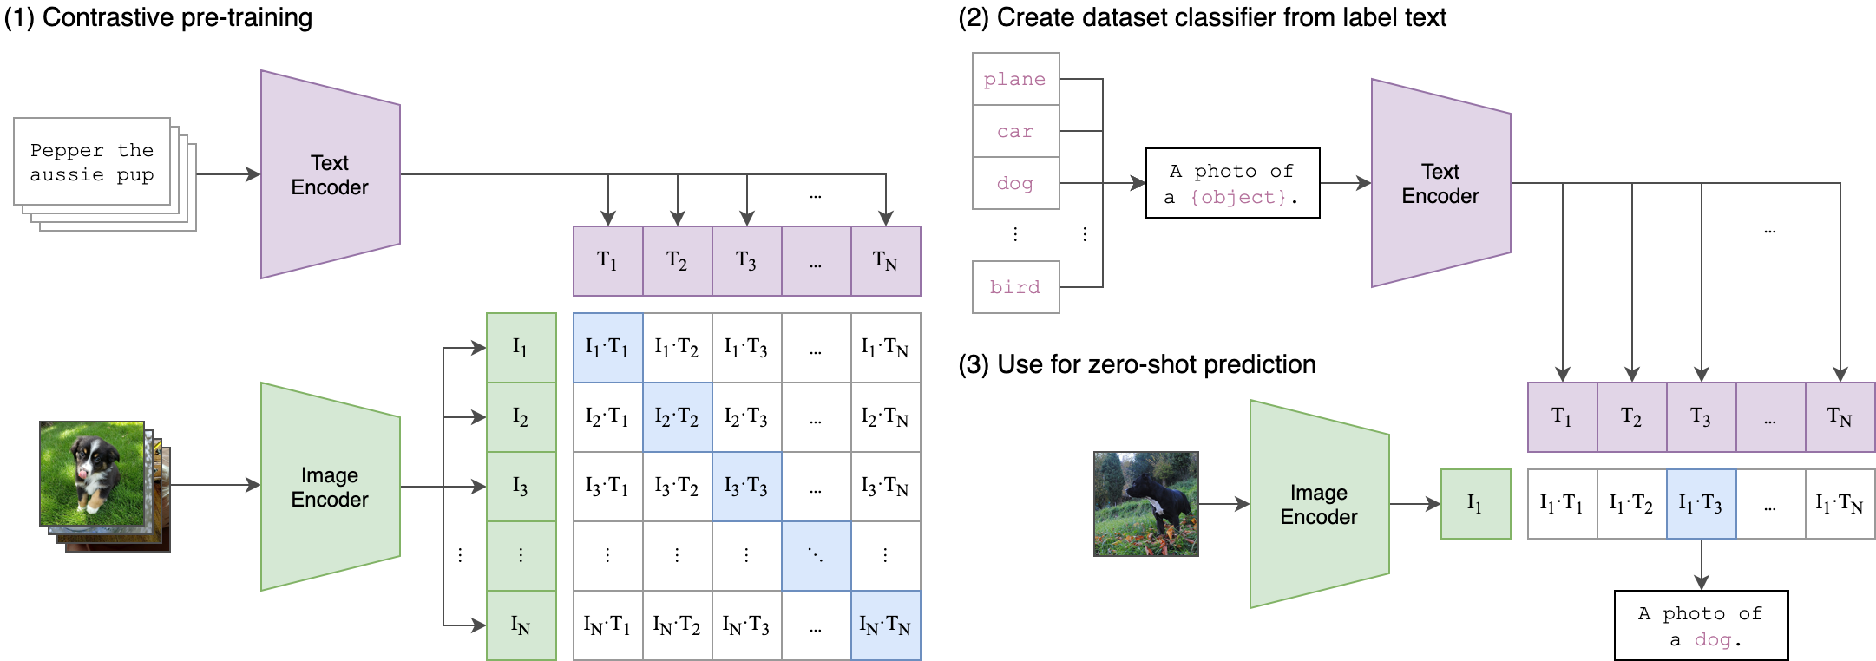
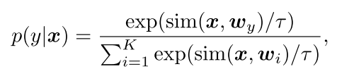
Review of CLIP
During training, CLIP[1] adopts a contrastive loss to learn
a joint embedding space for the two modalities.
[1] Alec Radford, ICML 2021, Learning Transferable Visual Models From Natural Language Supervision.

Slide 5
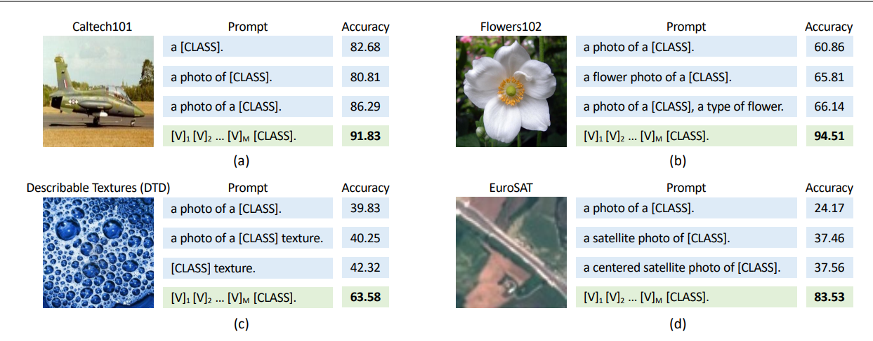
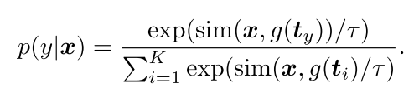
Context Optimization
Manually designed prompt needs to be carefully tuned.
The prompt in CoOp [2] for the $i$-th class, denoted by $t_{i}$, is $t_{i}=\{v_{1},…,v_{M}, c_{i}\}$
[2] Kaiyang Zhou, Learning to Prompt for Vision-Language Models.

Slide 6
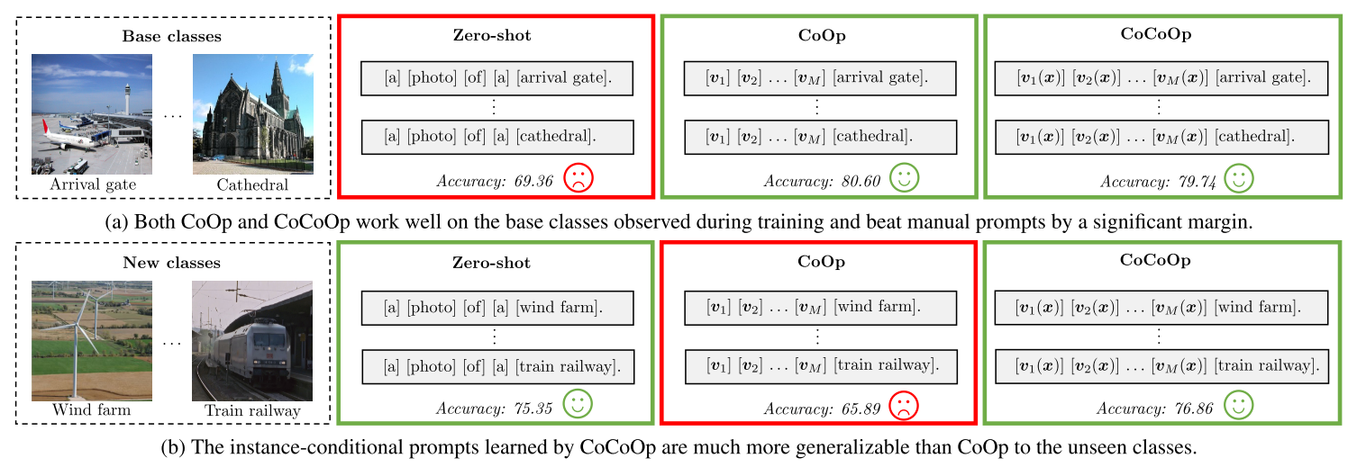
Motivation
Problem of CoOp: the learned context is not generalizable to wider unseen classes within the same task.
The learned context overfits the base classes, thus failing to capture more generalizable elements that are vital for broader scene recognition.

Slide 7
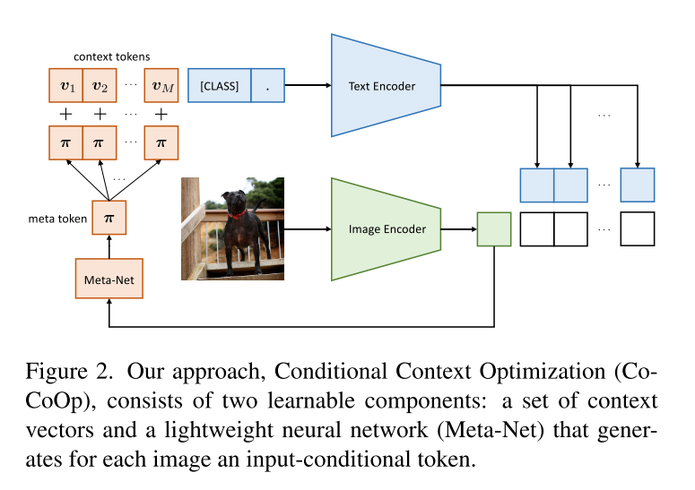
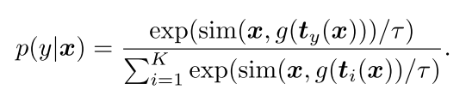
Conditional Context Optimization
The prompt in CoCoOp for $i$-th class is $t_{i}\left(x\right)=\left\{v_{1}\left(x\right),…,v_{M}\left(x\right),c_{i}\right\}, v_{m}\left(x\right)=v_{m}+π, π=h_{θ}\left(x\right).$

Slide 8
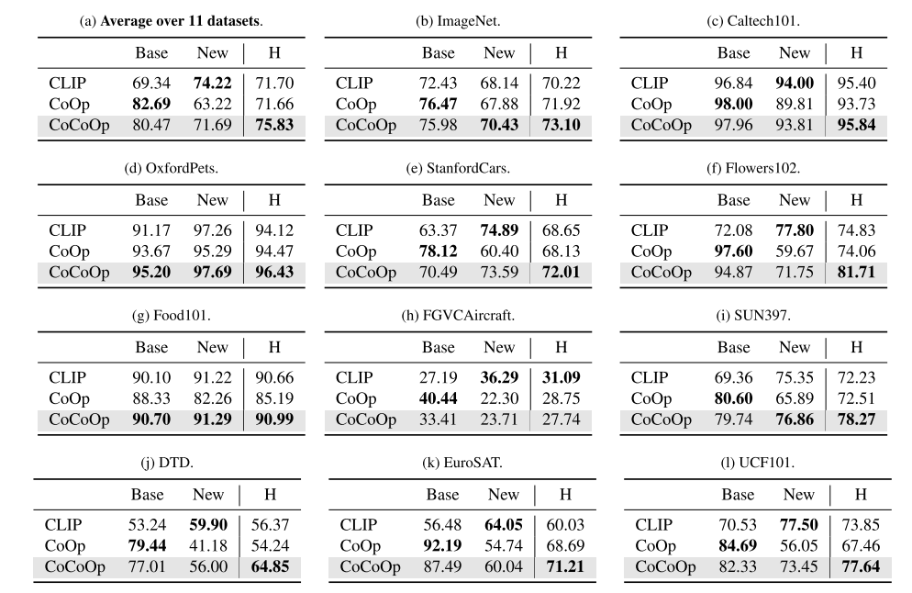
Generalization Experiments

Slide 9
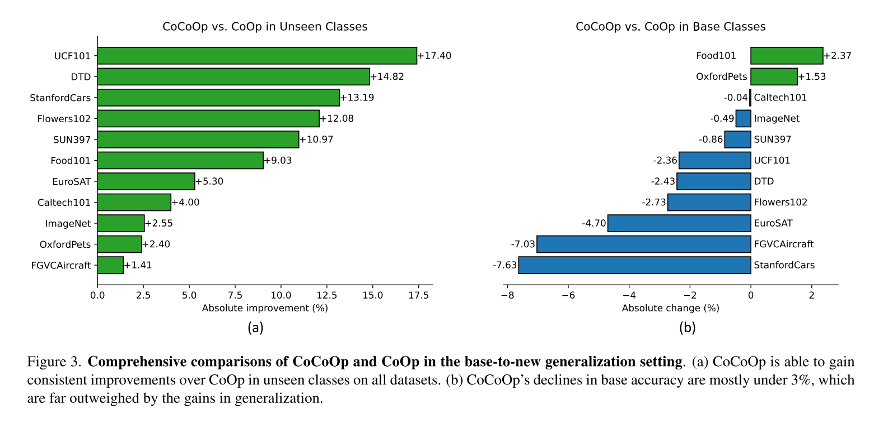
Generalization Experiments

Slide 10
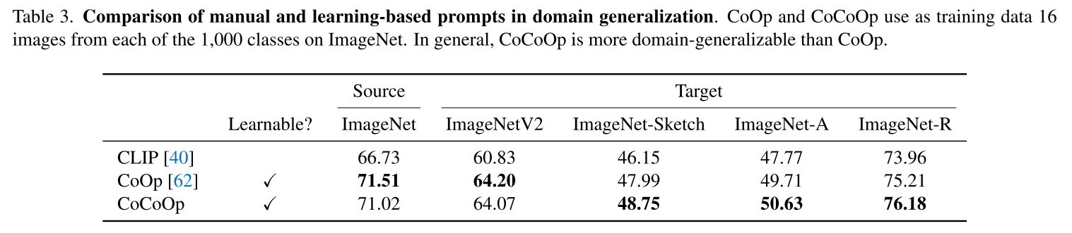
Generalization Experiments

